Slide 1


THE IMPACT OF THE NAVY ON THE ATHENIAN DEMOCRACY AND THE ECONOMY DURING THE FOURTH CENTURY BC:
SIGNS OF AILMENT OR OF WELL-BEING?
Vincent Gabrielsen
Prof. dr.phil. Vincent Gabrielsen
Saxo Institute, University of Copenhagen

Slide 2
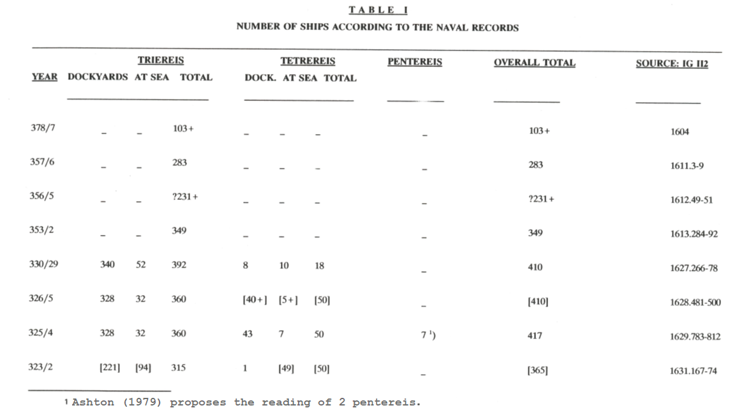

Slide 4
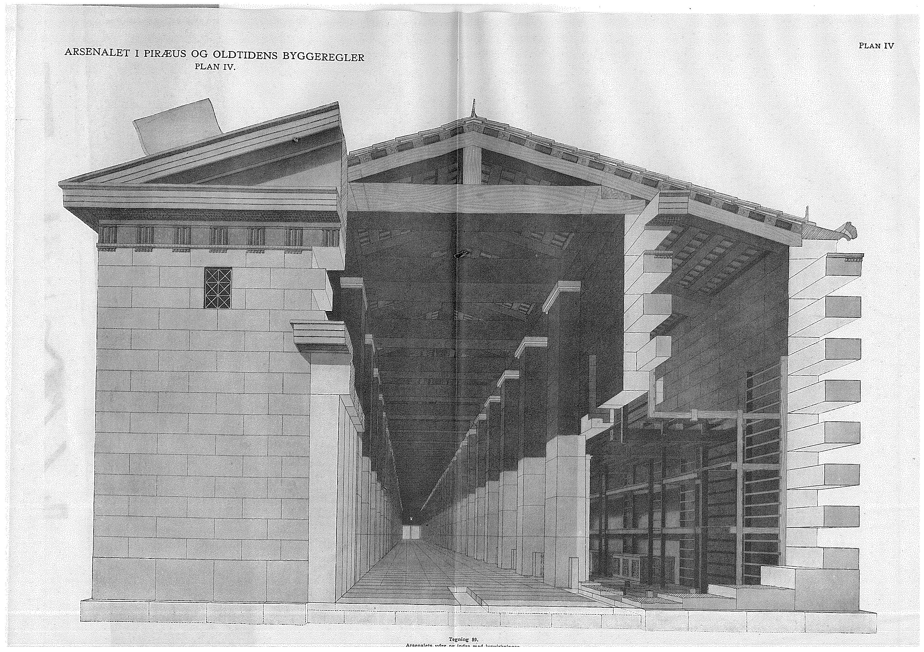

Slide 5
[Dem.] 50.7
ἐγὼ δ' ἐπειδή μοι οὐκ ἦλθον οἱ ναῦται οἱ καταλεγέντες ὑπὸ τῶν δημοτῶν, ἀλλ' ἢ ὀλίγοι καὶ οὗτοι ἀδύνατοι, τούτους μὲν ἀφῆκα, ὑποθεὶς δὲ τὴν οὐσίαν τὴν ἐμαυτοῦ καὶ δανεισάμενος ἀργύριον πρῶτος ἐπληρωσάμην τὴν ναῦν, μισθωσάμενος ναύτας ὡς οἷόν τ' ἦν ἀρίστους, δωρεὰς καὶ προδόσεις δοὺς ἑκάστῳ αὐτῶν μεγάλας. ἔτι δὲ σκεύεσιν ἰδίοις τὴν ναῦν ἅπασι κατεσκεύασα, καὶ τῶν δημοσίων ἔλαβον οὐδέν.
Since only few of the oarsmen who had been listed by the demotai to serve came to me [sc. to Apollodoros’ ship in the Piraeus], and those few who did come were unfit, I dismissed them. And having mortgaged my property in order to borrow money, I was the first to man the ship, hiring the best oarsmen to be had by giving to each man generous bonuses and advance payments. More than that, I equipped the ship with equipment that was entirely my own possession, receiving not a single item from that belonging to the state.

Slide 6
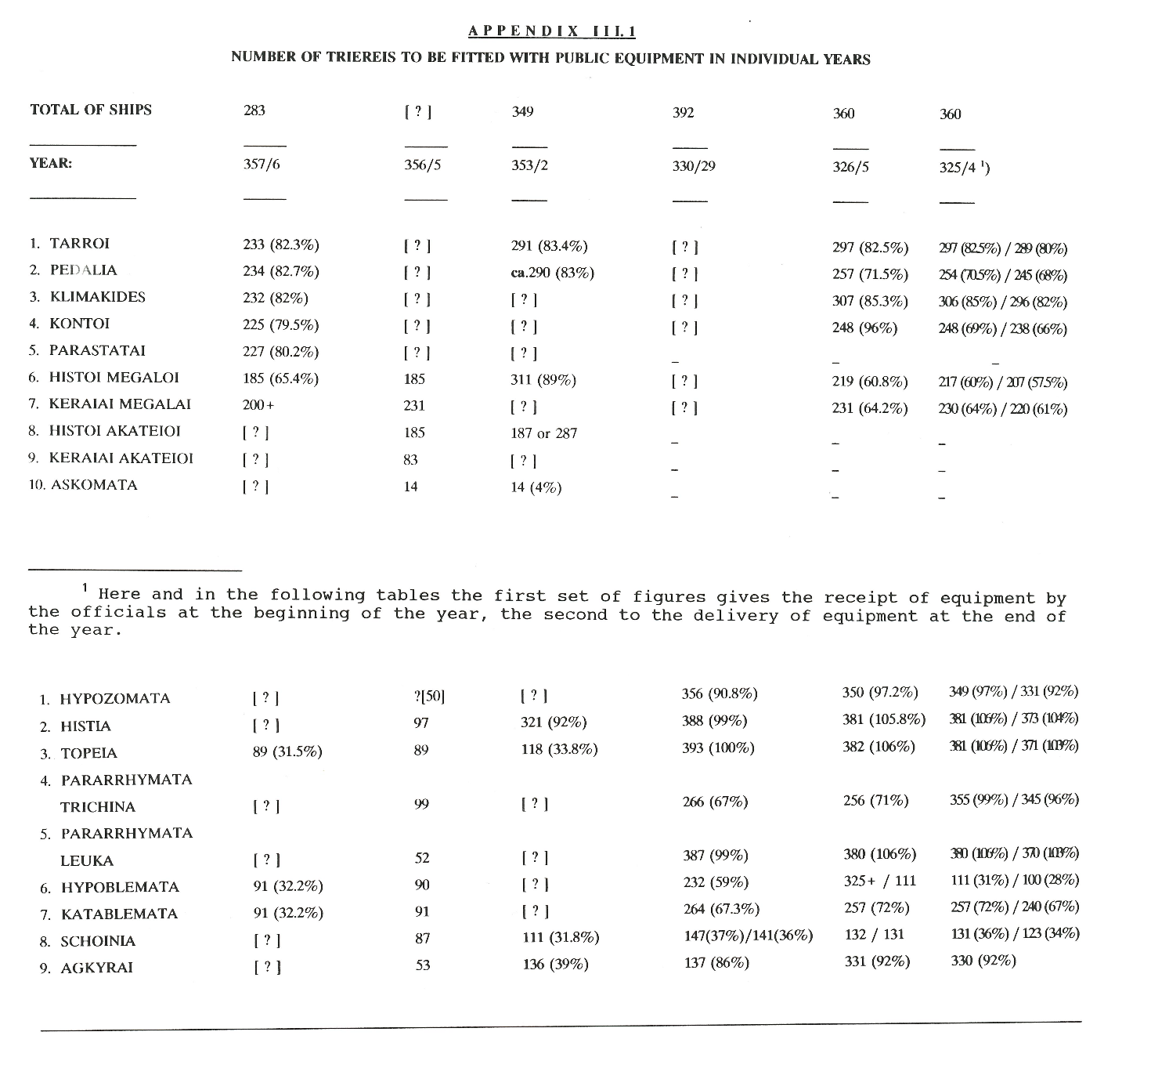

Slide 7
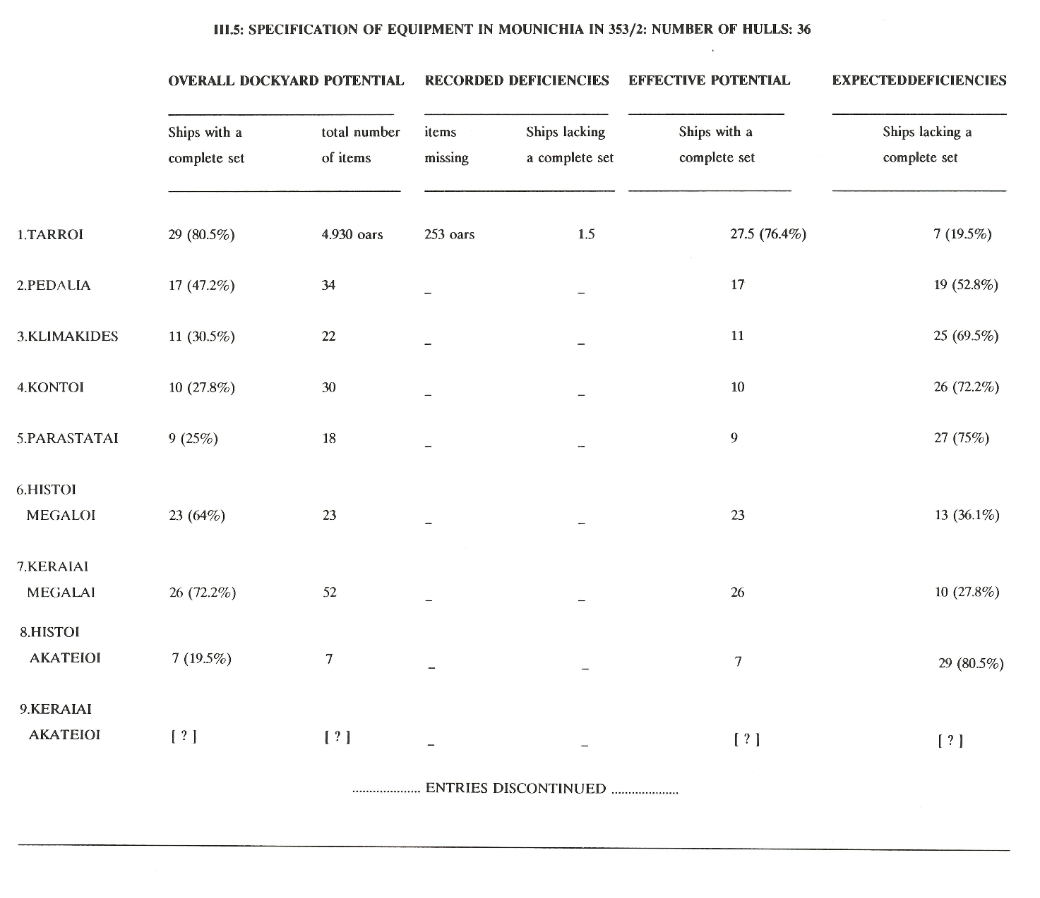

Slide 8
MONETARY VALUE OF SHIPS AND THEIR EQUIPMENT
In 431/0 BC there were approximately 400 trireme hulls whose value totalled 2 million drachmas, while the value of their equipment (set here at 2,169 drachmas per ship) was 867,600 drachmas, i.e. a grand total of 2 million, 867,600 drachmas.
In 357/6 BC the force of 382 triremes was valued at 1,414,000 drachmas (hulls) plus 613,827 drachmas (equipment),
i.e. a total of 2,027,827 drachmas.
In 325/4 BC the corresponding figures were 2,085,000 drachmas for the 417 hulls (using the 5,000 drachmas equally for triremes, tetrêreis and pentêreis), while the total value of their equipment was 1,823,985 drachmas (4,100 drachmas per trireme, 6,105 drachmas per tetrêrês and per pentêrês). The grand total for that year was 3,908,985 drachmas.
OPERATIONAL EXPENSES
For 431/0 BC, the total is 3,467,600 drachmas (50 ships active for a month) or 4,307,600 drachmas (120 ships active for a month).
For 357/6 BC, the total is 2,627,827 drachmas (50 ships active for a month) or 3,467,827 drachmas (120 ships active for a month).
For 325/4 BC, the total is 4,508,985 dr. (50 ships active for a month) or 5,348,985 drachmas (120 ships active for a month).
SOURCE: V. Gabrielsen, ’Financial, Human, Material and Economic Resources Required to Build and Operate Navies in the Classical Greek World’, in Ph. de Souza, P. Arnaud and Chr. Buchet (eds.), The Sea in History, vol. 1: The Ancient World. Suffolk and Rochester, New York, 2017, 426-442.

Slide 9
Members of Meidias' hetaireia (c.350 BC)
1. Meidias Kephisodorou Anagyrasios
2. Timokrates Antiphontos Krioeus => with Androtion
3. Polyeuktos Timokratous Krioeus => with Androtion
4. Diotimos Diopeithou Euonymeus => Grain Fund scheme
5. Mnesarchides Mnesarchou Halaieus Araph.
6. Neoptolemos Antikleous Meliteus => Grain Fund scheme
7. Philippides Philomelou Paianeus => Grain Fund scheme
8. Euktemon (nicknamed 'dusty')
9. Blepaios the Banker => hoi eranistai hoi meta Blepaiou

